Slide 3
Proximity determines volume

Slide 4
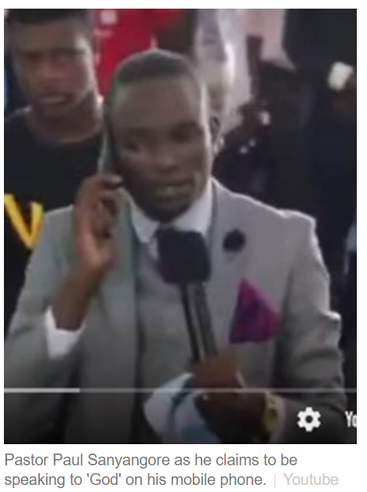

Slide 5
Your take away today is:
3 steps to Draw Closer to God + Hear Him

Slide 6
Proximity determines volume

Slide 7
Rest Hear: Take A Rest in Hear
Draw near to God, and he will draw near to you. Cleanse your hands, you sinners, and purify your hearts, you double-minded.
James 4:8 (ESV)

Slide 8
Love His Word
Clear the Room
Trust His Voice

Slide 9
Love His Word
Clear the Room
Trust His Voice

Slide 10
Love His Word
And he said to me, “Son of man, feed your belly with this scroll that I give you and fill your stomach with it.” Then I ate it, and it was in my mouth as sweet as honey. And he said to me, “Son of man, go to the house of Israel and speak with my words to them.
Ezekiel 3:3-4

Slide 11
Love His Word
You are looking for a whisper in the wind and ignoring the 783k words from God in your hand!

Slide 12
Love His Word
Vocabulary
Litmus Test
Strengthens Your Faith

Slide 13
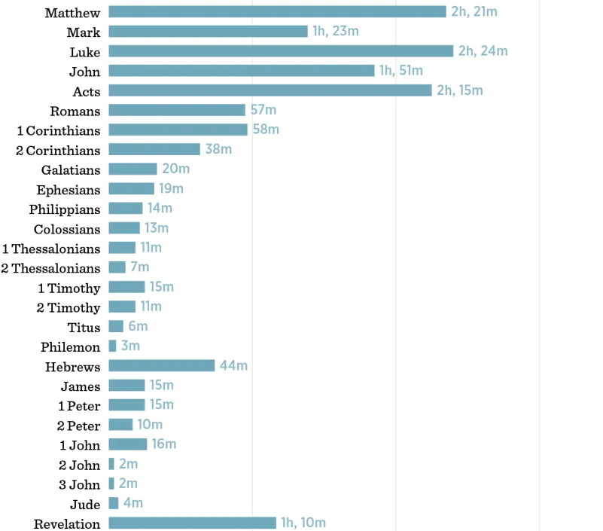
Love His Word
Vocabulary
Litmus Test
Strengthens Your Faith

Slide 14
Love His Word
Clear the Room
Trust His Voice

Slide 15
Inchindown Oil Tanks
770 ft long
30 ft wide
44 ft high

Slide 16
Clear the Room
When the unclean spirit has gone out of a person, it passes through waterless places seeking rest, but finds none. 44 Then it says, ‘I will return to my house from which I came.’ And when it comes, it finds the house empty, swept, and put in order.
Matthew 12:43-44

Slide 18
Love His Word
Clear the Room
Trust His Voice

Slide 19
Trust His Voice
Give ear, and hear my voice; give attention, and hear my speech.
Isaiah 28:23

Slide 20
Trust His Voice
How do we know it’s God?
Time + Familiarity

Slide 21
Love His Word
Clear the Room
Trust His Voice

Slide 22
Act Today!
Schedule 1 hour a day for Bible Reading and Prayer
Incorporate the Word of God into your Rest
Be a prescriber of the Word.

Slide 23
Act Today!
Schedule 1 hour a day for Bible Reading and Prayer
Incorporate the Word of God into your Rest
Be a prescriber of the Word.

